Slide 1
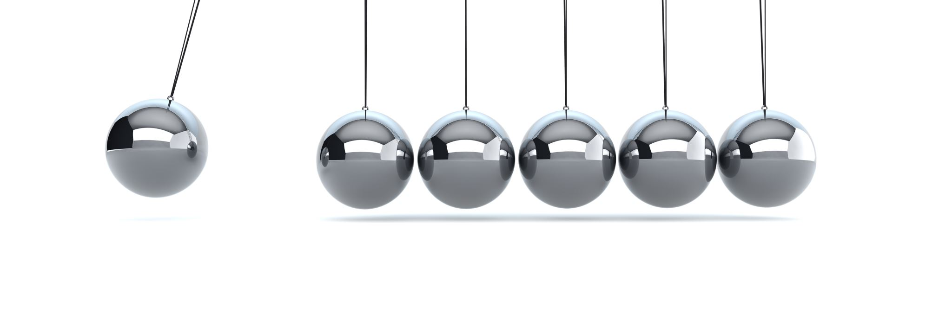


Customer churn
By Shichao Zhou

Slide 2

Research questions
Which model has the best performance to predict whether customers churn or not?
Did the preferred model perform as well as expected?

Slide 3
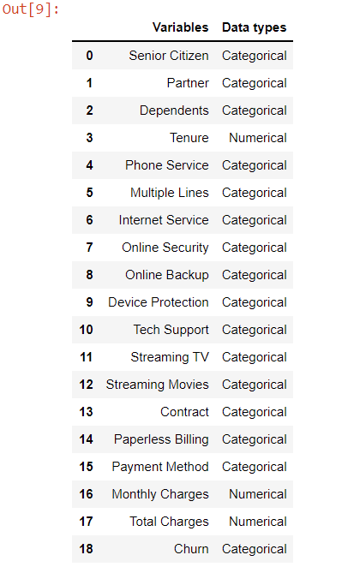
Data set overview
Data set Source: IBM( https://community.ibm.com/accelerators/catalog/content/Customer-churn )
Dataset shape : 7043 rows, 21 variables. （Drop two non-predictive variables.）
Missing data: ‘Total charges’ has 11 missing data. (Replace with 0)
Response variable: Churn

Slide 4
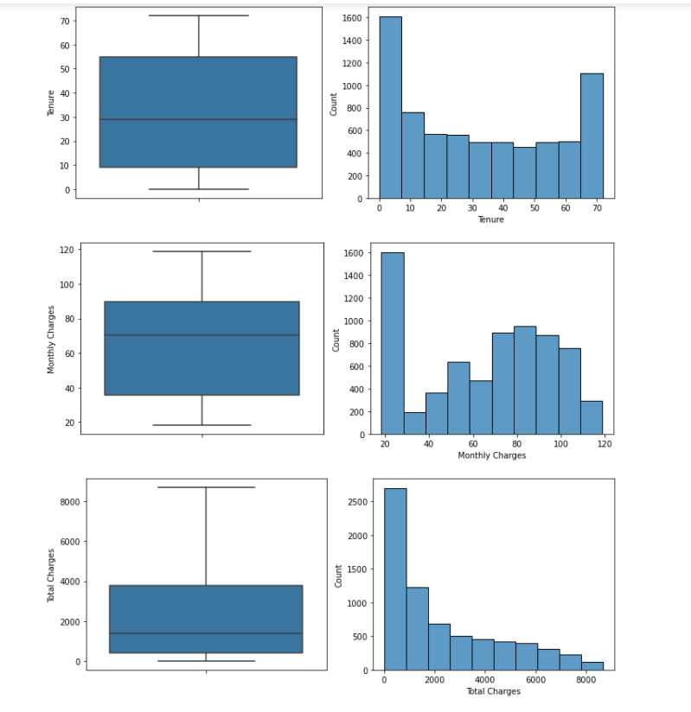
EDA
Numerical variables: histogram & boxplot
Different scales
No exaggerated outliers

Slide 5
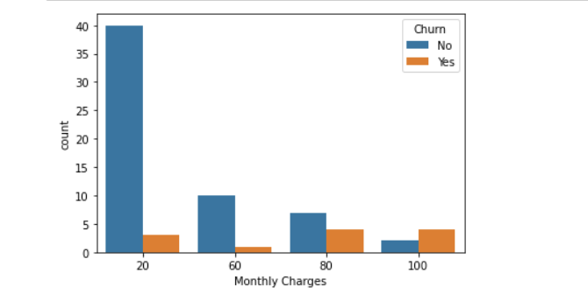
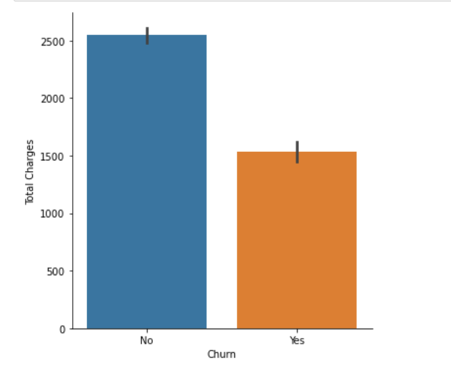
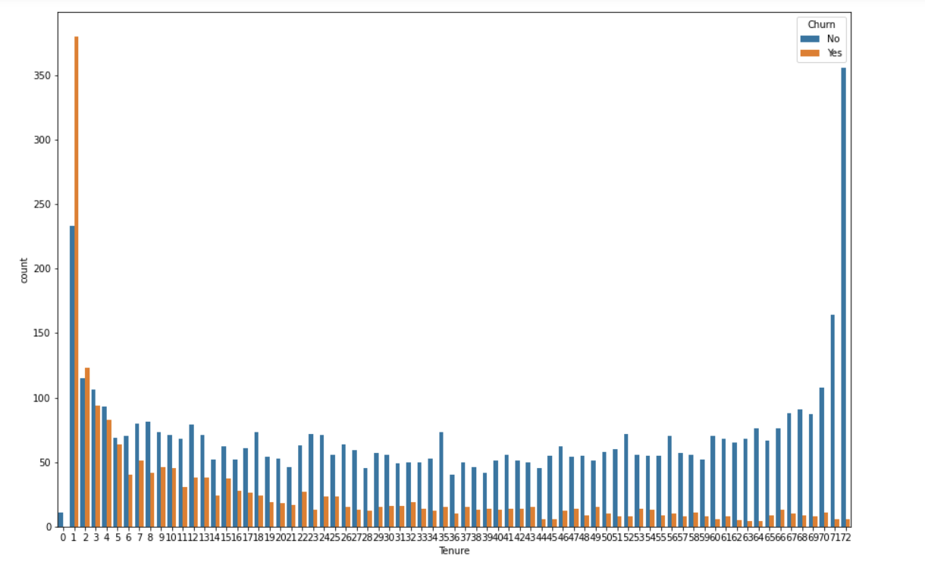
EDA
Countplot and catplot: show the relationship between numerical and response variable ( categorical variable)

Slide 6
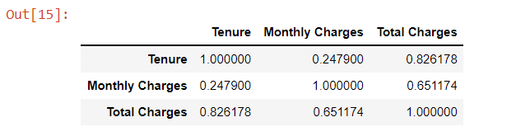
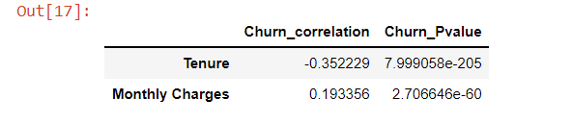
EDA
Graph 1: show the correlation between numerical variables.
Graph 2: Point-biserial correlation measure the relationship between a binary response variable(Churn) and continuous variables.

Slide 7
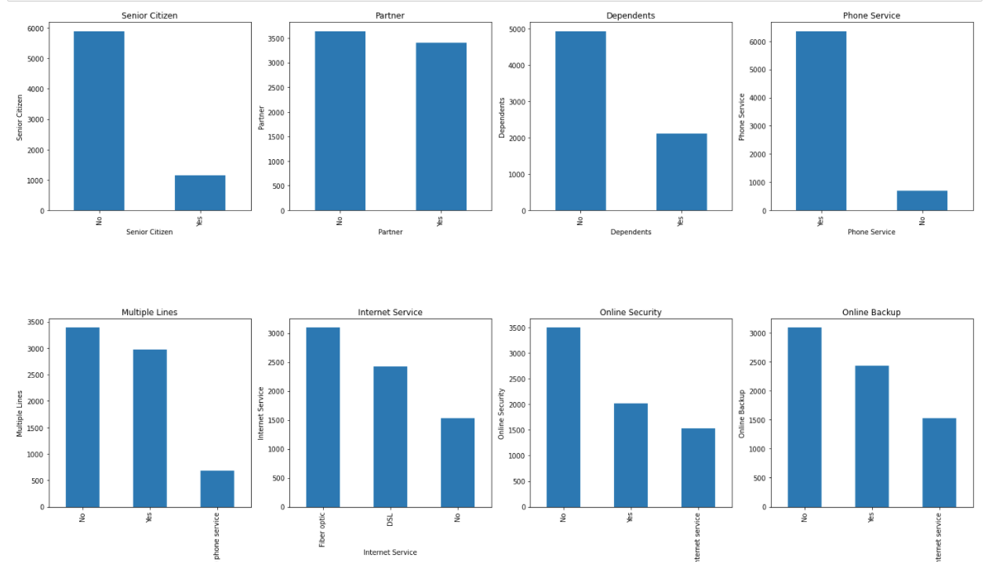
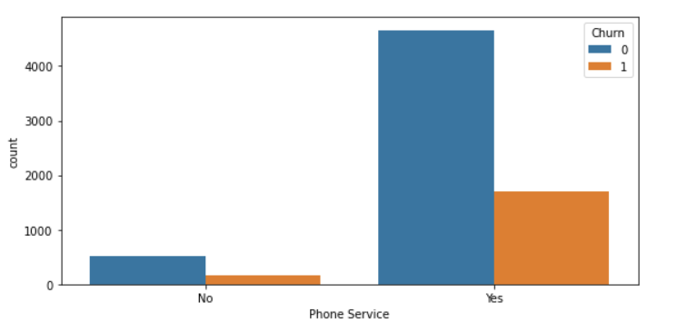
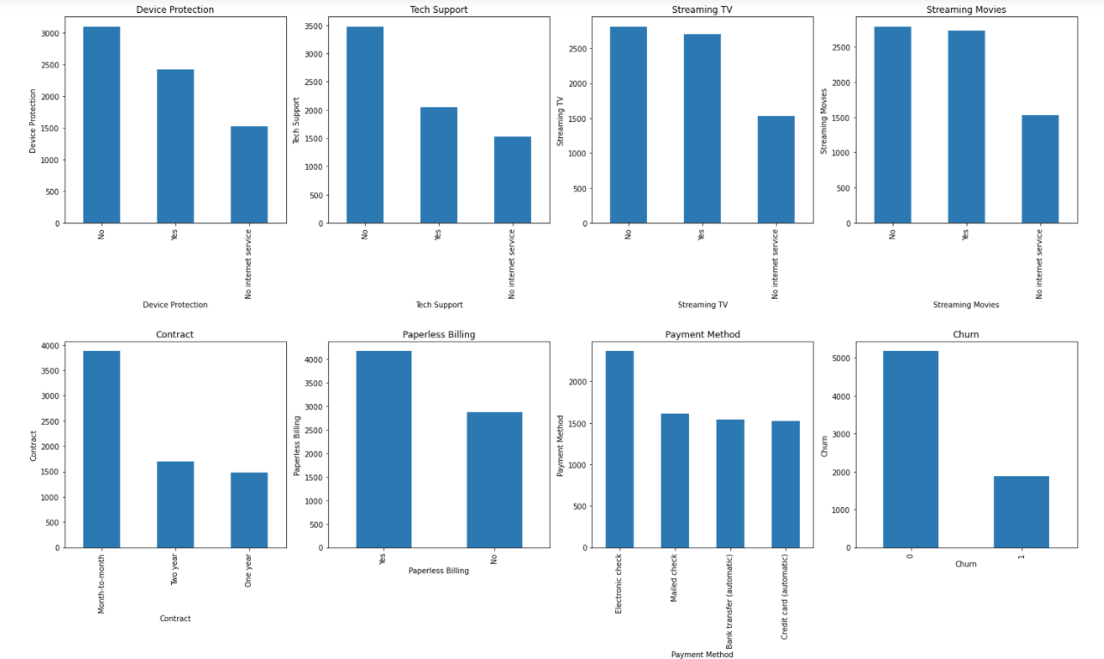
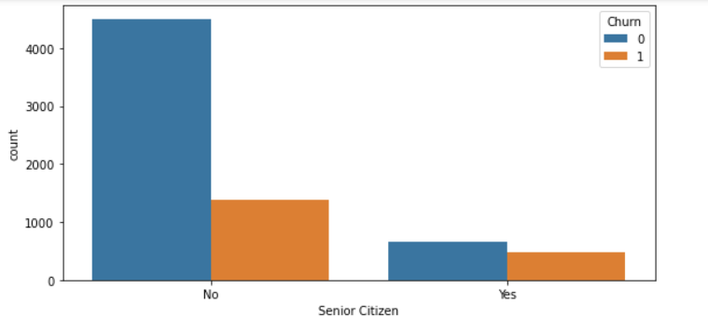
EDA
Categorical variables: barplot & countplot

Slide 8
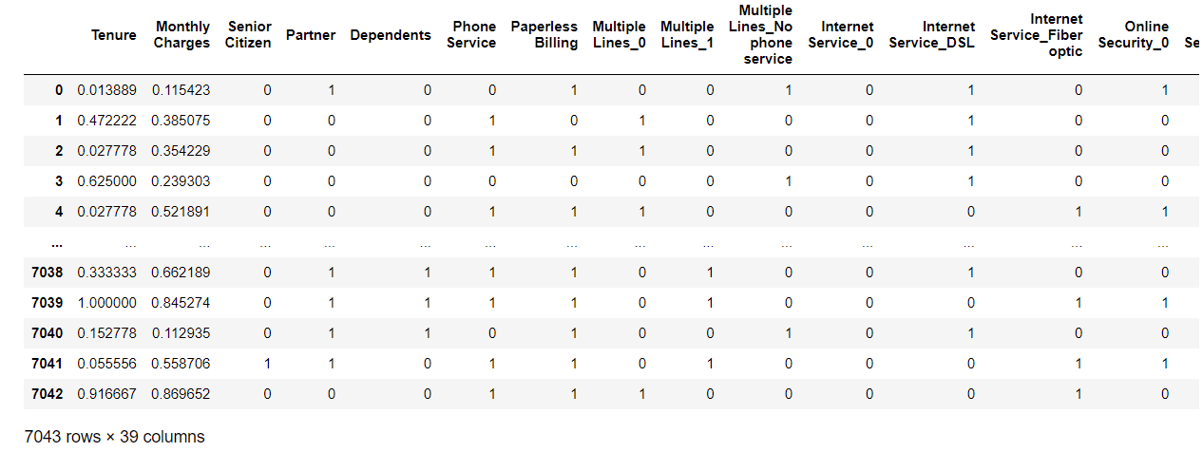
Data preparation
Dummy categorical variables
MinMax standardize numerical data

Slide 9
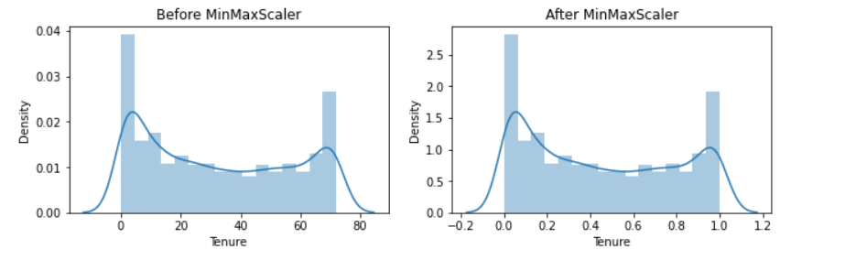
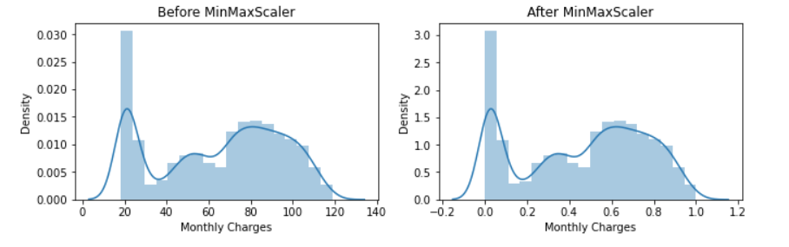
Prepped data review
After standardization and filling missing data, the data are all in the same range. The distribution of the dataset has not changed.

Slide 10
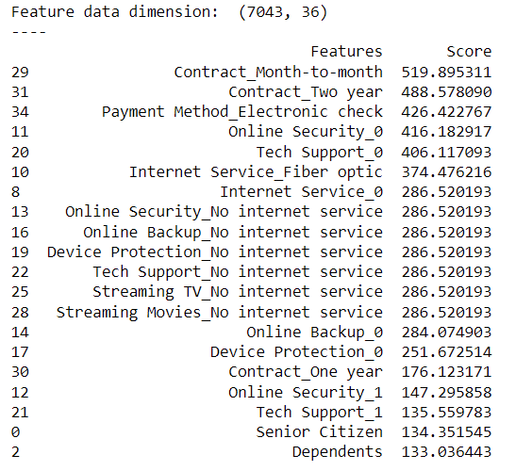
Feature selection
Numerical variables: Tenure and monthly charge( EDA results)
Categorical variables: SelectKBest(Chi2)

Slide 11
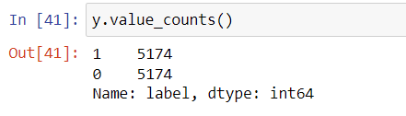
Model construction
Null error rate :73.46% ( 0:5174,1:1869)
After Over-sampling, the null error rate is now 50%
KNN classifier
Decision Tree classifier
XGBoost
Naïve Bayes

Slide 12
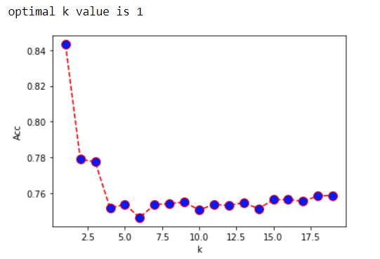
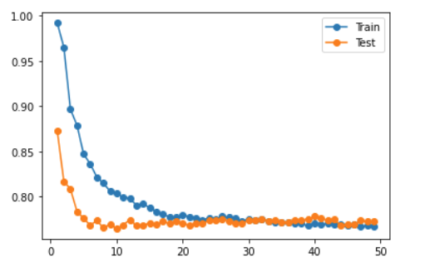
Model construction
KNN classifier
n_neighbors: ( default value K= 5)
Distance:euclidean distance (default value P =2)

Slide 13
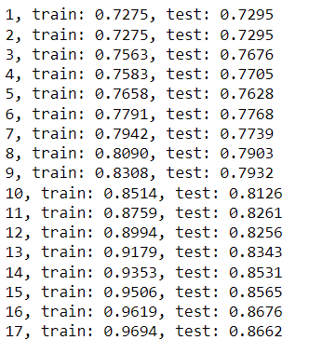
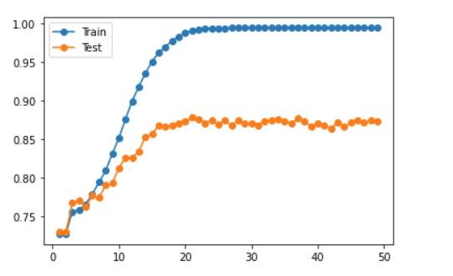
Model construction
Decision Tree classifier
max_depth: 10
criterion: gini (less computationally expensive)

Slide 14
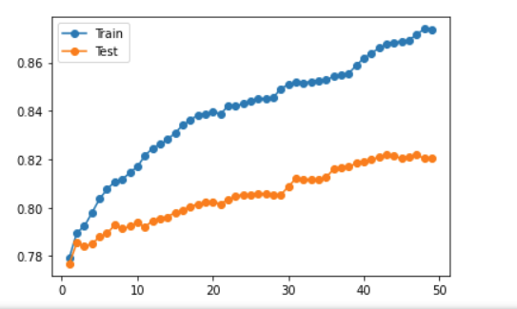
Model construction
XGBoost
n_estimators : 16
objective: ‘binary:logistic’

Slide 15
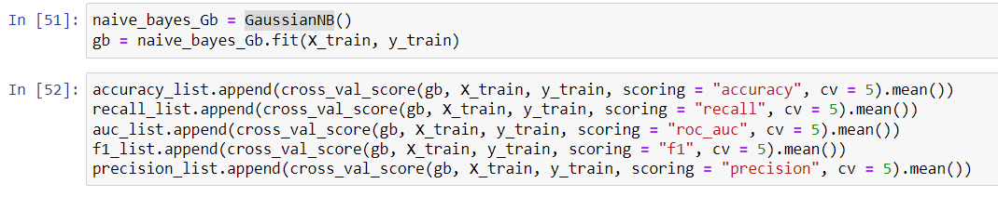
Model construction
Naïve bayes
Customer churn is one of the major used application of Naive Bayes

Slide 16
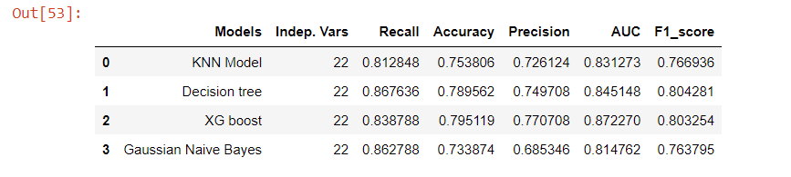
Model selection
XG boost is preferred model.
The highest accuracy,precision and AUC score among the 4 models.

Slide 17
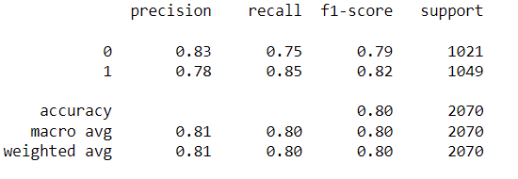
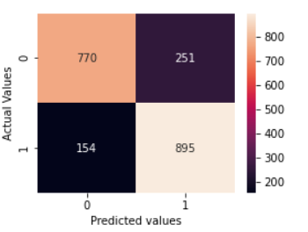
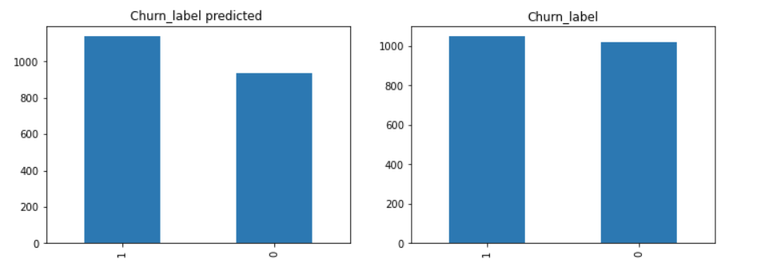
Testing
Test XG boost subset
Only 405 observations were misclassified. The accuracy is 80% (training set accuracy is 79.51%)

Slide 18
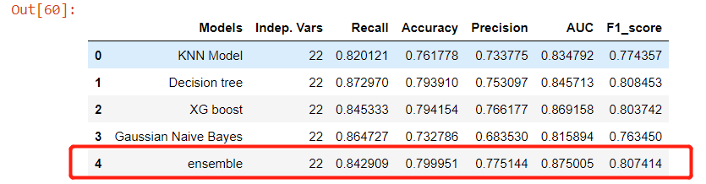
Ensemble model
Data
KNN
SVM
Logistic
Decision tree

Slide 19
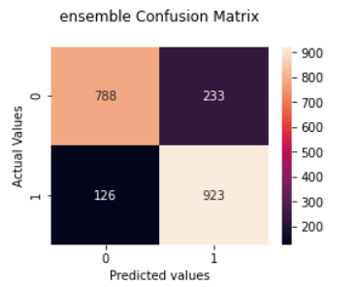
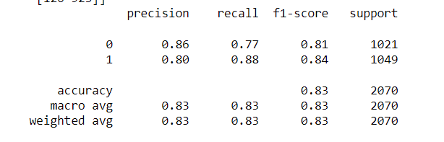
Testing Ensemble model
Only 359 observations were misclassified. The accuracy is 83% (training set accuracy is 79.99%)

Slide 20
Challenge
In the initial training, the training set accuracy was extremely low, only about 50%-60%.
Solutions to improve performance:
Apply over-sampling
Increase the number of features from 10 to 22.
Tuning hyperparameters

Slide 21

Thank you!

